Slide 1
Initial Patient Assessment
Sendie saint-Fleur
Hernandez. D
Keiser university
17th August 2021

Slide 2
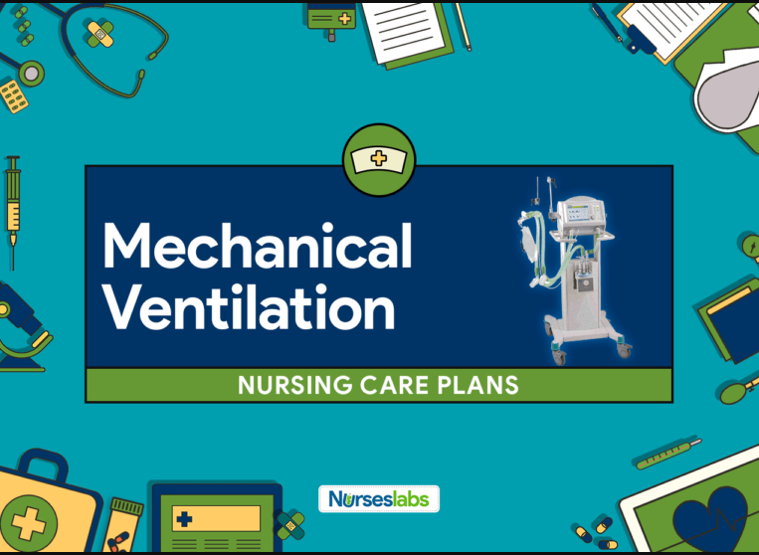
Initial Patient Assessment
The mechanical ventilation technique helps in assessing the patient's vital signs
It allows for the evaluation of patients' health status
It is effective in checking on the patients' temperature, heart rate, and blood pressure
Notes:
Assessing the patient's signs of the blood pressure, temperature, and heart rate are some of the most common practice that a health care professional should consider to determine their health condition. The mechanical ventilation technique is one of the most efficient methods of assessing the patient's signs such as blood pressure, heart rate and temperatures (Cairo, 2019). It allow the for he evaluation of patients' health status which is done continuously by checking on their temperature, heart rate, and blood pressure.

Slide 3
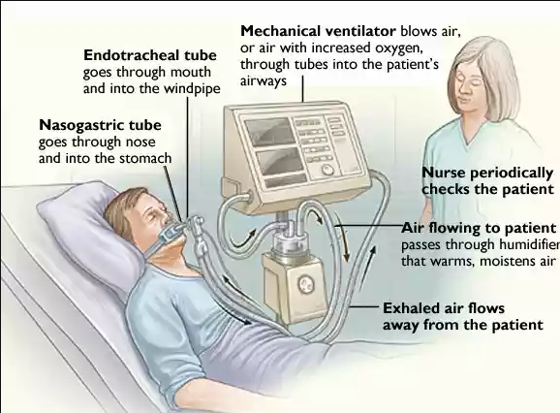
How the ventilation mechanism is useful
The ventilation mechanism helps to monitor the patient's heart
Helps healthcare providers evaluate the patient's health status before making a professional decision on patient's health.
The ventilator notifies the clinicians of vital cardiovascular signs and any other changes related to the patient heart rate.
Notes:
The ventilation mechanism allows the health care professional to monitor the patient's heart condition daily with the help of a mechanical ventilator. The ventilator allows the health care professionals to carefully evaluate the health status of patients before making a professional decision concerning their health. The ventilator has a unique alarm mechanism that alerts the clinician on changes patients' health condition. The ventilator has alarms activated to give a notification on an increase in their temperature or the heart rate hence calling the clinicians attention to the patient. The ventilator notifies the clinicians on cardiovascular signs and any changes related to the patient heart rate.

Slide 4
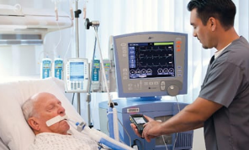
How mechanical ventilation and Heart rate
Mechanical ventilation measure the heart rate of the patient
Helps in assessment of heart rate changes
Notifies patient in case their health status worsen
Notes:
The ventilator measures the heart rate of the patient. Furthermore, it continually assesses the changes in heart rate and notifies the clinician in case the patient's health deteriorates. The have electrocardiogram that enables continuous monitoring of the patient’s heart rate. Patients under the ventilator need to be monitored changes in heart rate using an electrocardiogram.

Slide 5
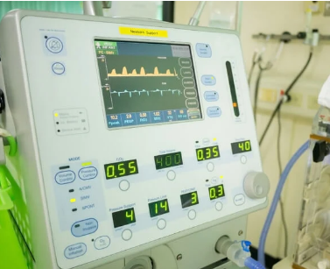
Cont..How mechanical ventilation and Heart rate
The mechanical ventilation checks the minimum or the maximum heart rate of the patient
It enables the clinician to give the patient clinical attention
It is useful for the healthcare professional to improve services offered in healthcare
Notes:
The system also has a set of alarms that helps notify the clinician if the patient's heart rate deteriorates or exceeds the average rate. This system also checks the minimum or the maximum heart rate of the patient. The clinician is alerted if the patient's heart rate goes beyond the minimum or exceeds the required maximum rate. This type of system enables the clinician to give the patient clinical attention on a time hence improving the healthcare services offered.

Slide 6
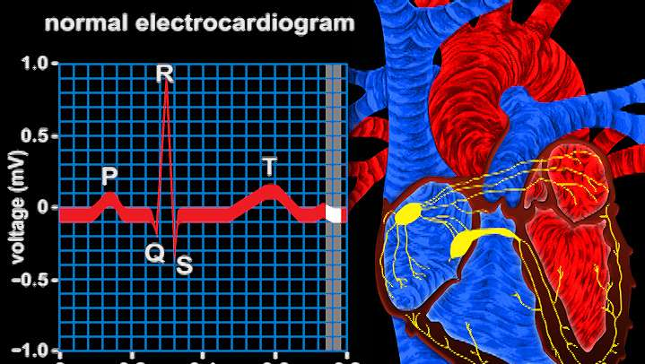
Cont...The mechanical ventilation and Heart rate
The electrocardiogram is placed in the correct position on the patient to allow the system to work effectively
It placed in chest position to detect the patient's heart rate
The leads are also placed for the system to display information monitor for the clinician to observe heart rate.
Notes:
The healthcare professional places the electrocardiogram in the correct position on the patient to allow the ventilators to work effectively. The clinician ensures the electrocardiogram is placed on the patient's chest and in the correct position to detect their heart rate. The electrocardiogram is placed close to the clavicle and intercostal pace on the left side of the midaxillary line. The leads are also placed to ensure that the system displays them on the monitor for the clinician to observe heart rate.

Slide 7
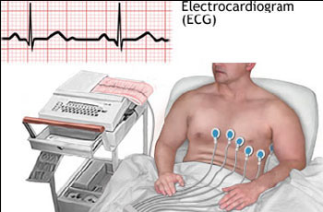
Cont...How mechanical ventilation and Heart rate
The computers scan the electrocardiogram to detect any changes in the heart rate of the patient
It works with close integration of alarms to notify clinician detect heart rate changes
The activation of alarm depends on factors such as disconnection of electrocardiogram electrodes from the patient or if the ventilators are disconnected from the patient's body
Notes:
The computers scan the electrocardiogram to detect any changes in the heart rate of the patient. The close integration of alarms helps notify the clinician if the monitors detect danger on the heart rate. The activation of alarm depends on dangerous factors such as disconnection of electrocardiogram electrodes from the patient or if the ventilators are disconnected from the patient's body. Other factors that affect the heart rates include anxiety, stress or reaction to drugs taken by the patient. These factors contribute to change in the heart rate of the patient. It is recommended that an initial 12- lead electrocardiogram be obtained when a patient has respiratory failure and is aged 21 years or below.

Slide 8
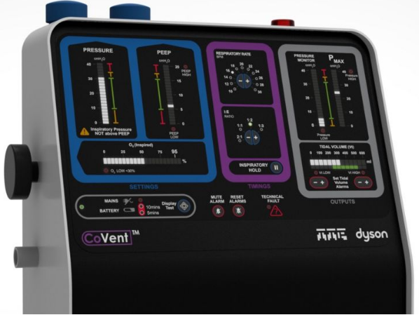
The mechanical ventilation and Temperature
The machine is useful in monitoring patient’s temperature
The clinicians use the mechanical ventilation machines to determine temperature of a patient
It is mostly done through patient’s mouth
Notes:
Monitoring the patient's temperature is another important issue to consider when determining their Health. There are various techniques that a clinician can apply to measure the temperature of the patent. One of the most effective ways of measuring the patient’s temperature is through the mouth or oral means.

Slide 9

Cont:..How mechanical ventilation and Temperature
Several factors affect the average body temperatures of the patient
Some of these factors includes hypothermia, tissue necrosis, and fever
high body temperatures of the patient can be caused by Leukaemia and other metabolic-related diseases
Notes:
Several factors affect the average body temperatures of the patient and thus, clinician needs to be familiar with them and know how they affect the body temperature of the patient. Some of these factors includes hypothermia, tissue necrosis, and fever, resulting from surgical trauma experienced by the patient. Leukaemia and other metabolic-related diseases are also some of the possible causes of the high body temperatures. It is recommended that the clinician assess the patient's body temperature before giving a clinical judgment concerning the patient health.

Slide 10
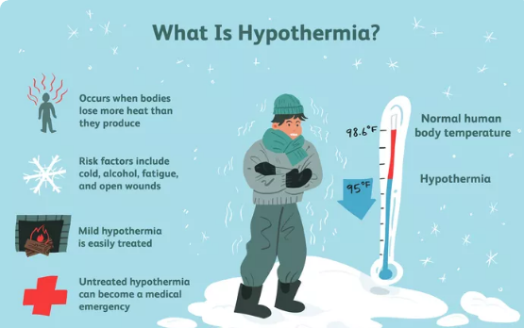
Cont:..How mechanical ventilation and Temperature
Hypothermia cause an increase in body temperature
This hypothermia results from Metabolic disorder
The health care professionals need to analyze the patient's physical condition and vital signs
Notes:
Hypothermia, one of the significant factors that cause an increase in body temperature. This results from metabolic disorders such as disorders in the patient's central nervous system or other drugs taken by the patient. The health care professional should assess make the patients experience high body temperatures in order to solve their health problems. Lastly, the chapter concludes that it is essential for health care professionals to analyze the patient's physical condition and vital signs

Slide 11
References
Cairo, J. M. (2019). Pilbeam's Mechanical Ventilation E-Book: Physiological and Clinical Applications. Elsevier Health Sciences.

